Slide 1
Ben’s Platformer Game (3d) http://cis174finalbm.azurewebsites.net/

Slide 2
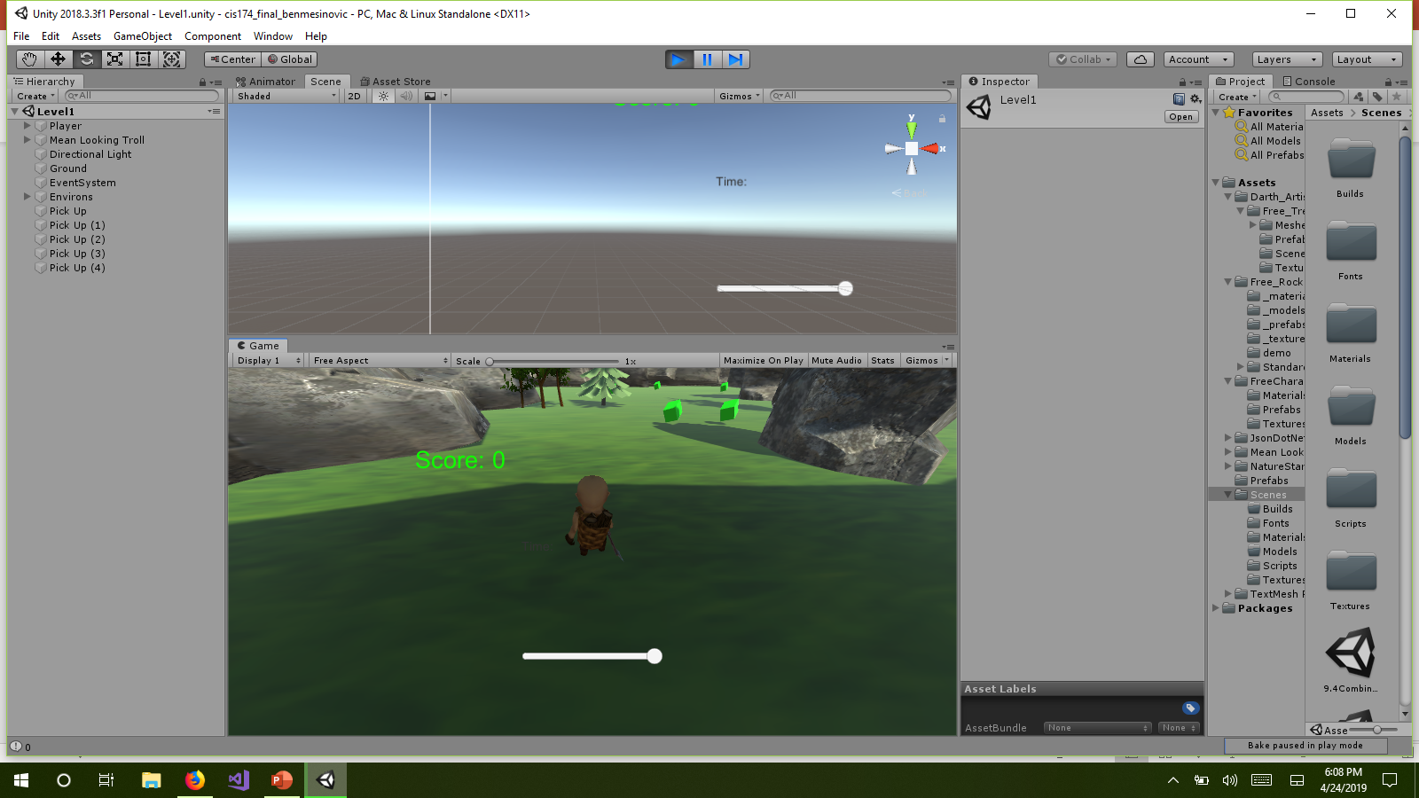
Couple of screenshots

Slide 3
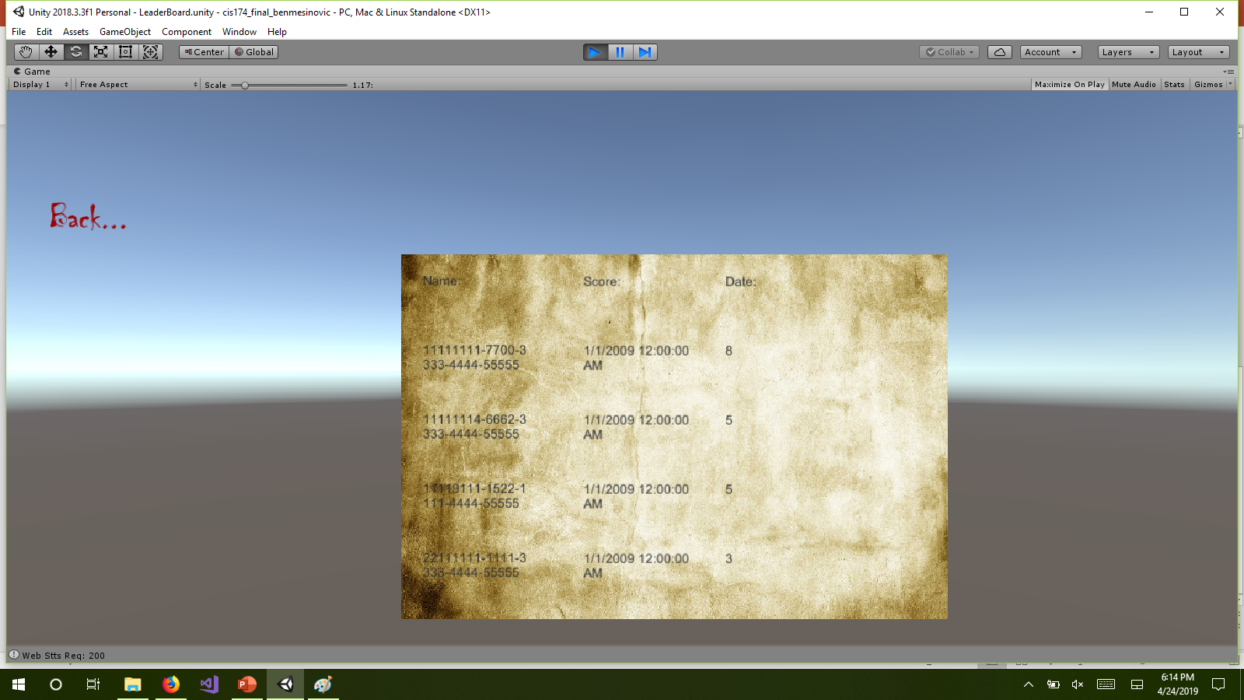
Leaderboard

Slide 4
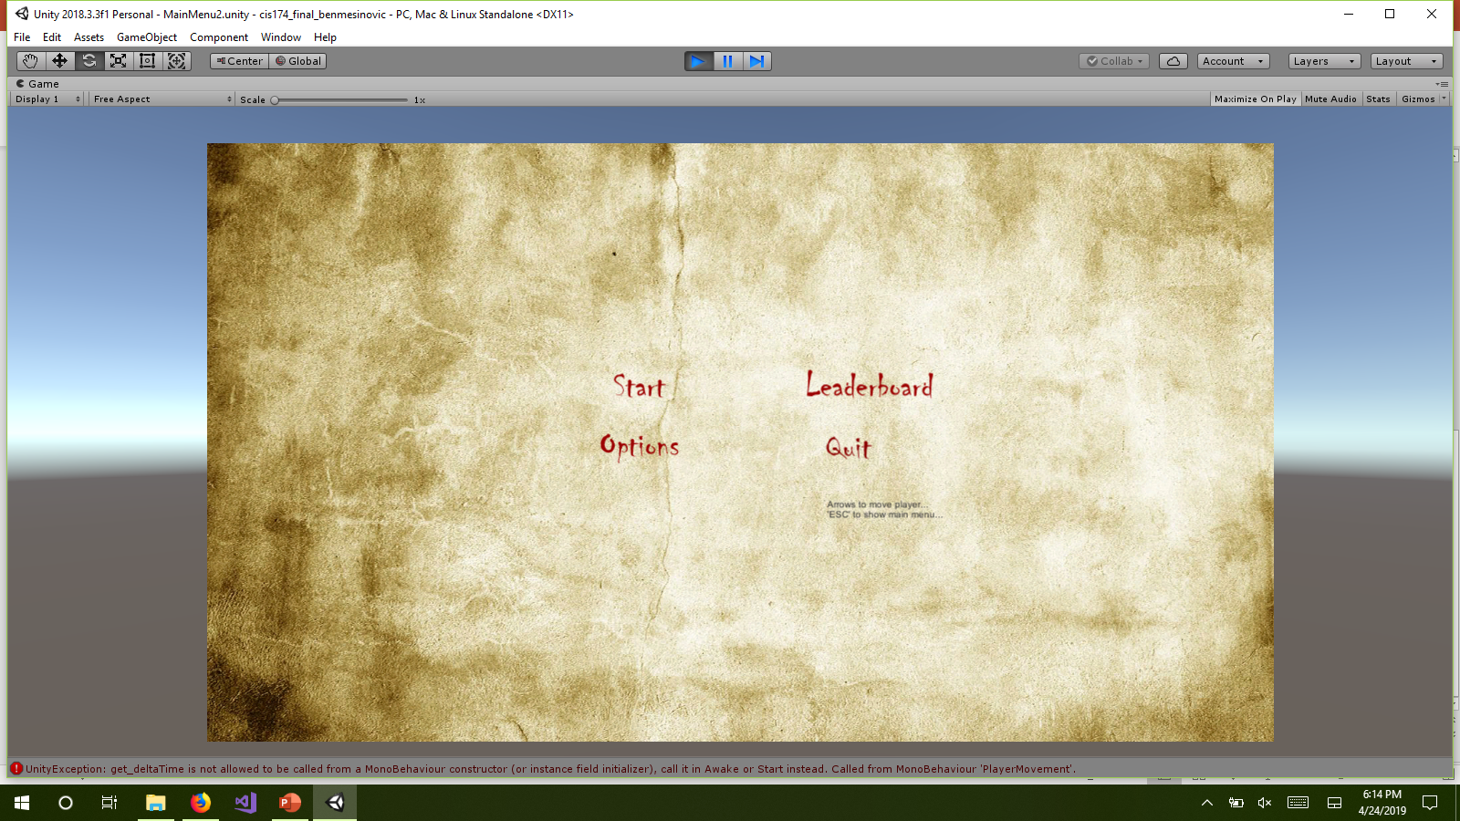
Main menu

Slide 5
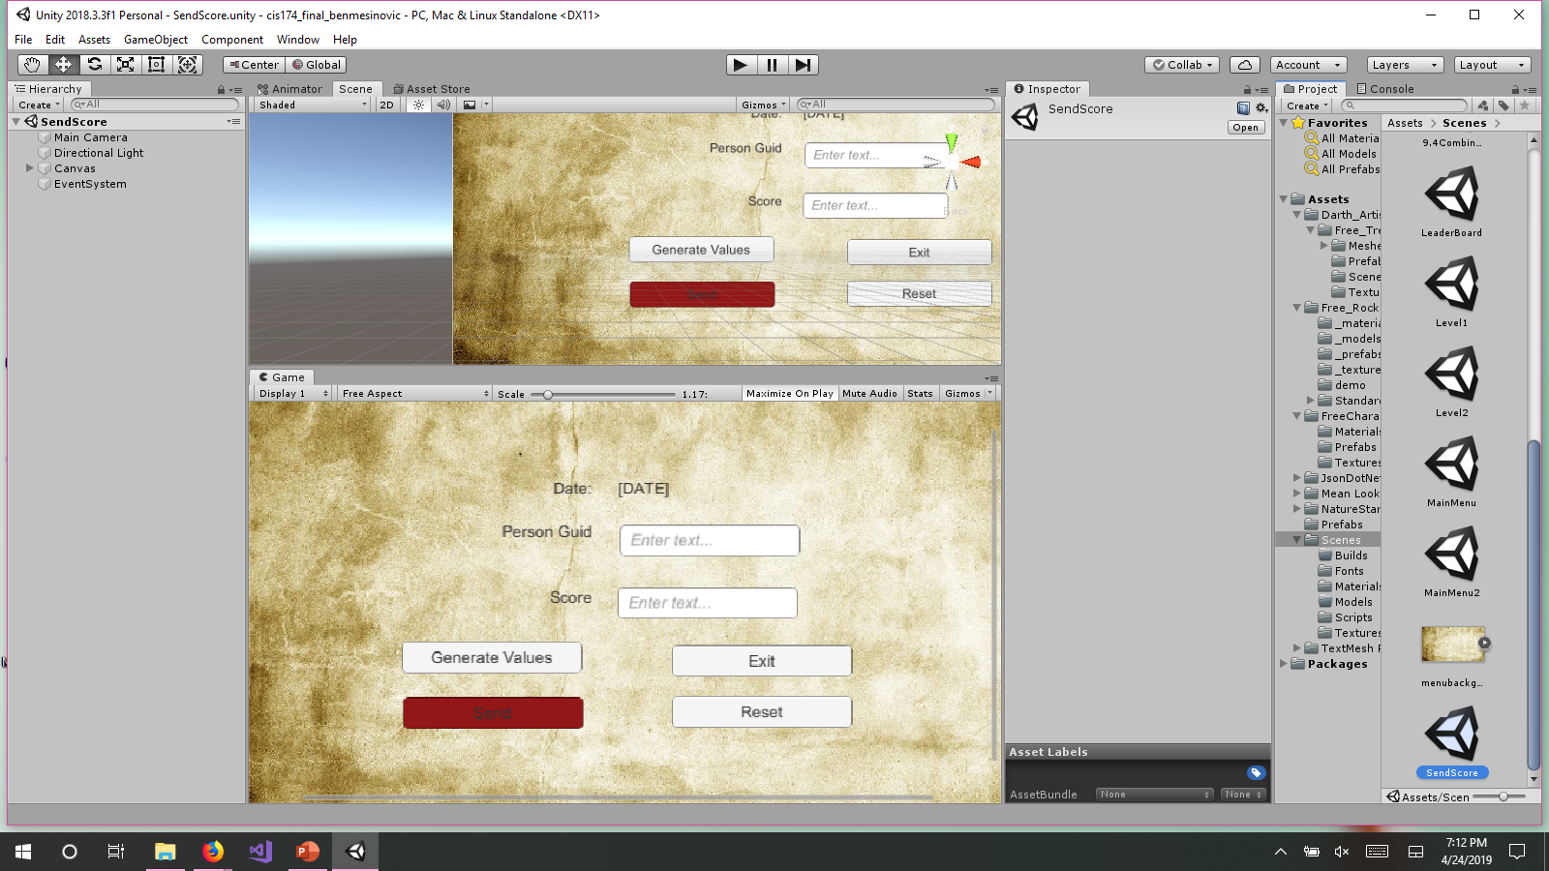
Send Score

Slide 6
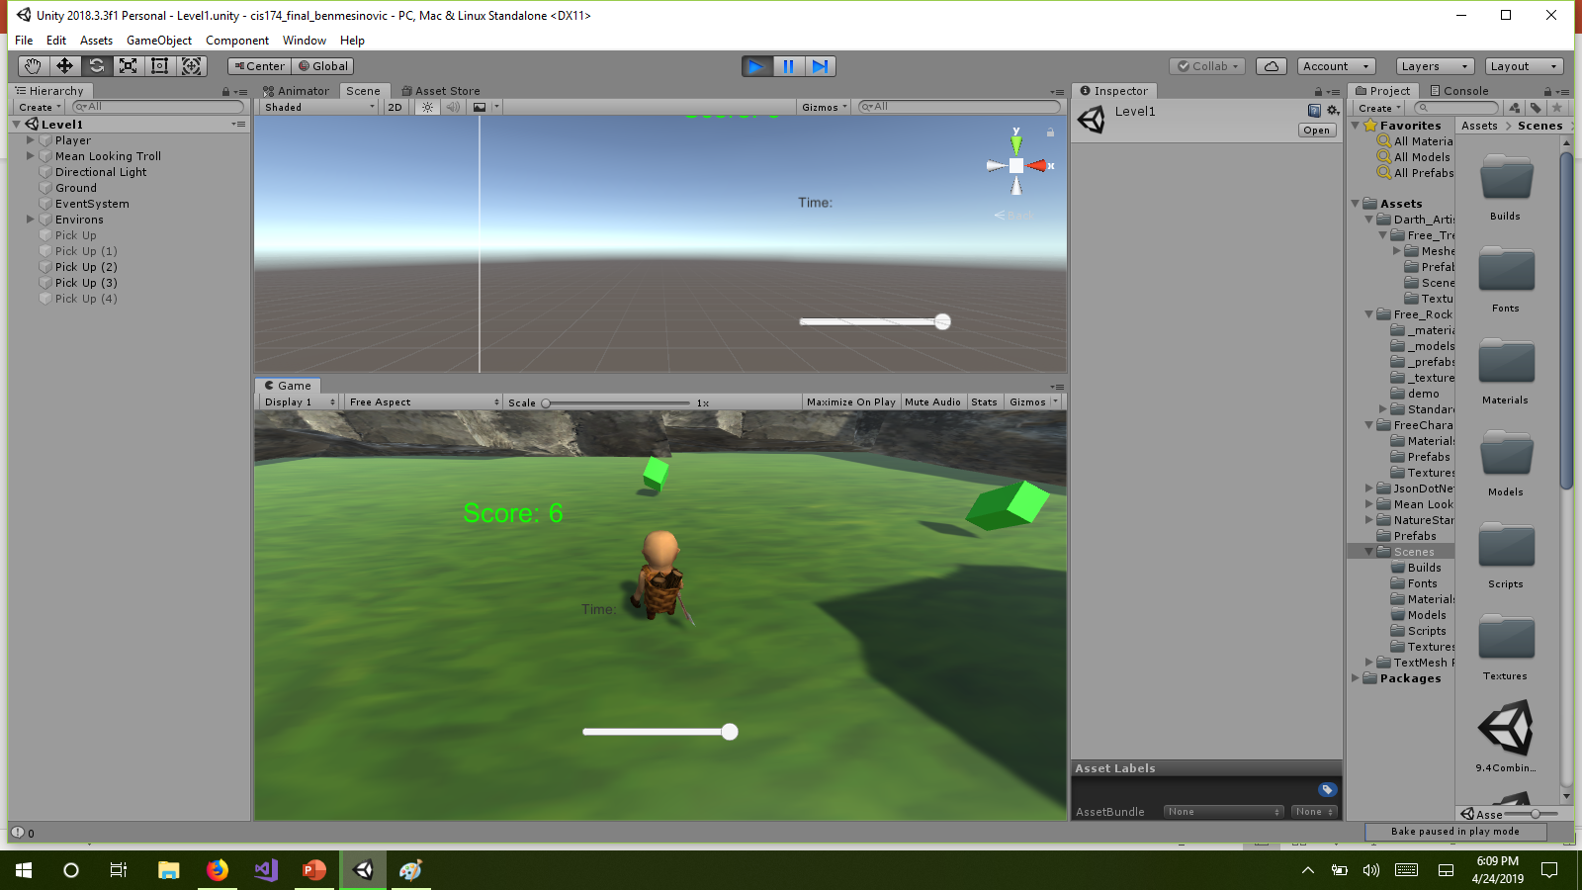
Extra gameplay

Slide 7
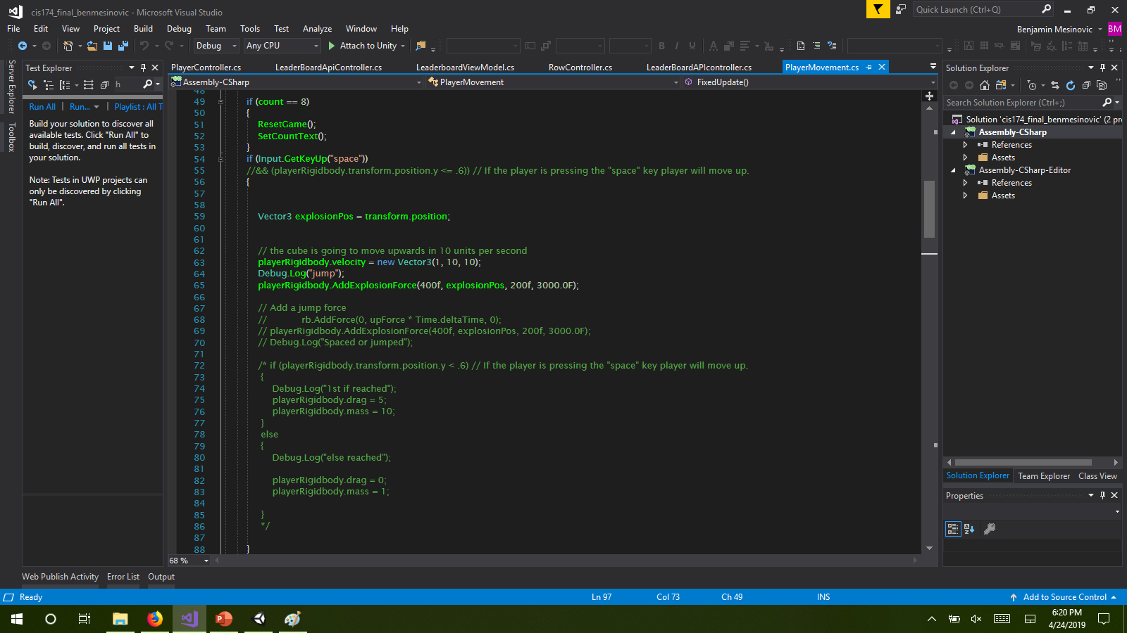
Issues: Unity, (player movement, API), Registration

